Slide 1
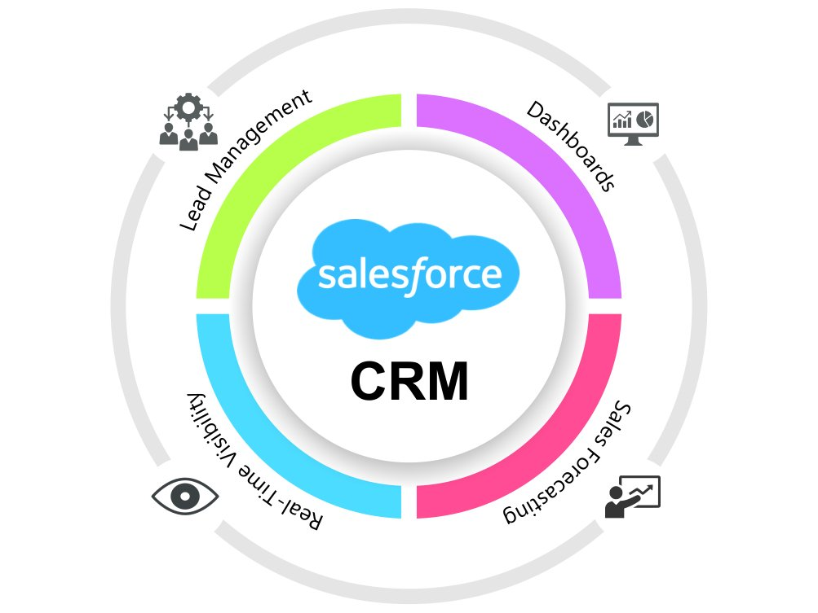
Sales CRM P261
Project Members:
Shahbaz Sayyed
Santhosh B
Sakshi Sanjay Verma
Harsha Langote
Harshada Santosh Palande
Pavan Kumar B R
Rahul Umesh H S

Slide 2
Summary:
Salesforce is an American Cloud based Software Company. It provides Customer Relationship management (CRM) software and applications focused on Sales, automation, and Analytics. The main objective of salesforce management is a strategy to increase business sales by doing analysis. A Salesforce lead is a potential customer, potential sales contact, potential sales opportunity. Leads are generated in many ways like from existing customer, referrals, through web, through online advertisements, campaigns and direct customers. Lead management is one of the key Functionality to improve business. A lead can be converted into a contact, an account, or an opportunity. To create an opportunity we've to consider few stages: contacted, working, unqualified, Converted and few parameters: lead's product interest, budget, timeframe.
Tools used: MS Excel, Tableau & Power BI.
SQL Server was used to write queries to create views by creating joins and SQL queries for other KPI’s.
Data was imported in Power BI by connecting to SQL Server.
Bar, Column and Combo Line Charts are used to create the visuals.
All the Score cards in both the Dashboards and Trend Analysis in opportunity Dashboard has been achieved by creating the measures using DAX functions like Calculate, Filter, Count, Sum and Quick measures were created to Calculated the Running Total for Trend Analysis.
Slicers like Year in opportunity dashboard and Lead Type and Industry in Leads Analysis Dashboard and are used that affects the visuals in both the dashboards when selected any value Navigation Buttons are added to navigate through both the Dashboards.

Slide 3
KPIs Found:
We had Total 10k Leads out of which only 411 converted to Opportunities at the conversion Rate 10.33%.
Highest Count of Leads by Lead Source came out to be 2786 to the Lead Source named "Inside Sales".
Highest Count of Leads by Industry is 5357 which belongs to the industry "Safety and Security".
Count of Total Active Opportunities is 1272.
Win Rate at which the sales team measures the success rate of sales team in converting an Opportunity into a sale came out to be: 31.06% while Opportunity Conversion rate is 27.38%.
Highest Count of Opportunities is 1143 for Biopharma/Pharmaceuticals Industry while highest Expected amount is 4.21M for Safety and Security Opportunity type.
Total opportunities v/s closed won opportunities is increasing till 2020 and suddenly decreases in 2021 having the final values 711 and 241.

Slide 4
This project is mainly focused to find KPI’s:
LEADS:
1. Total Leads
2. Converted Accounts
3. Converted Opportunities
4. Conversion Rate
5. Expected amount from Converted Leads
6. Lead by Source
7. Lead by Industry

Slide 5
OPPORTUNITY:
1. Active Opportunities
2. Expected Amount
3. Conversion Rate
4. Win Rate
5. Loss
6. Expected Amount by Opportunity Type.
7. Opportunities by Industry

Slide 6
8. Trend Analysis:
a) Running Total Expected Vs Commit Forecast Amount over Time
b) Running Total Active Vs Total Opportunities over Time
c) Closed Won Vs Total Opportunities over Time
d) Closed Won vs Total Closed over Time

Slide 7
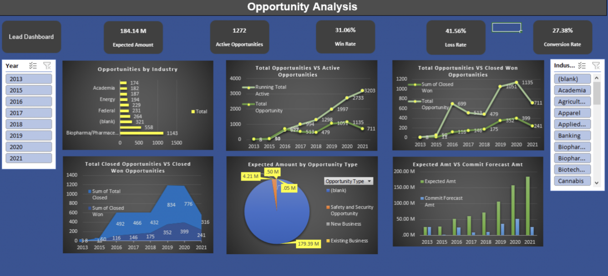
MS Excel:

Slide 8
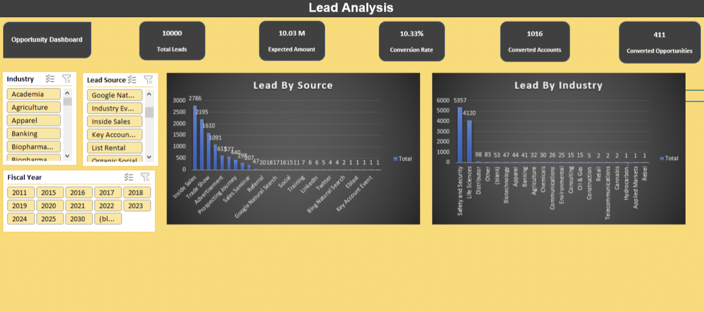
MS Excel:

Slide 9
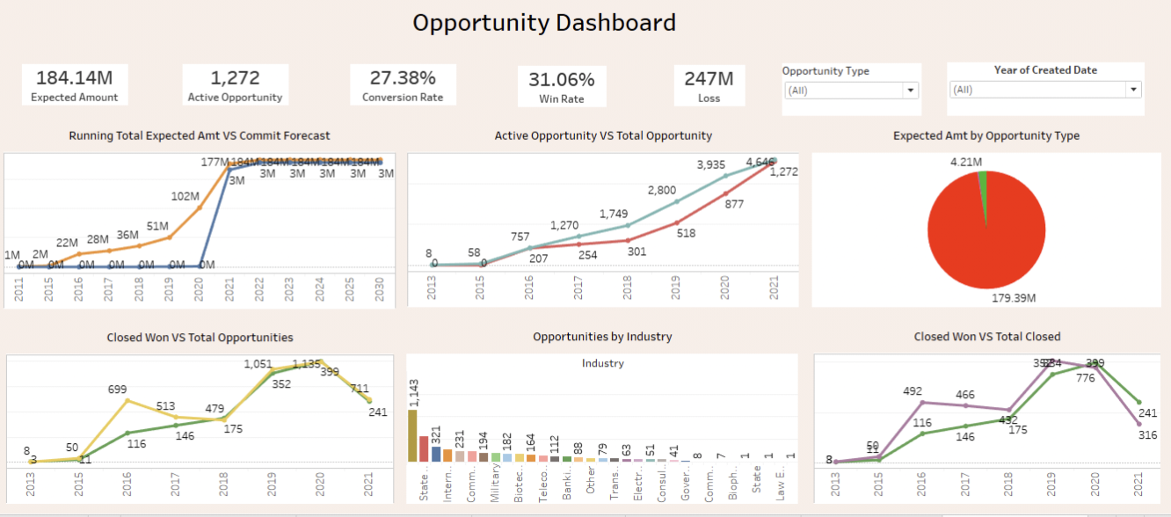
Tableau:

Slide 10
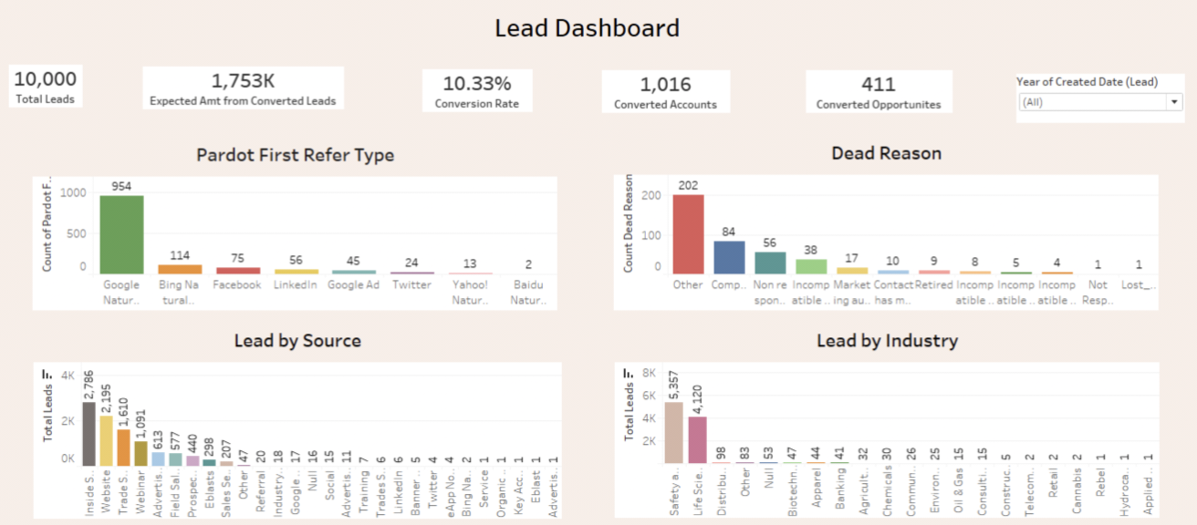
Tableau:

Slide 11
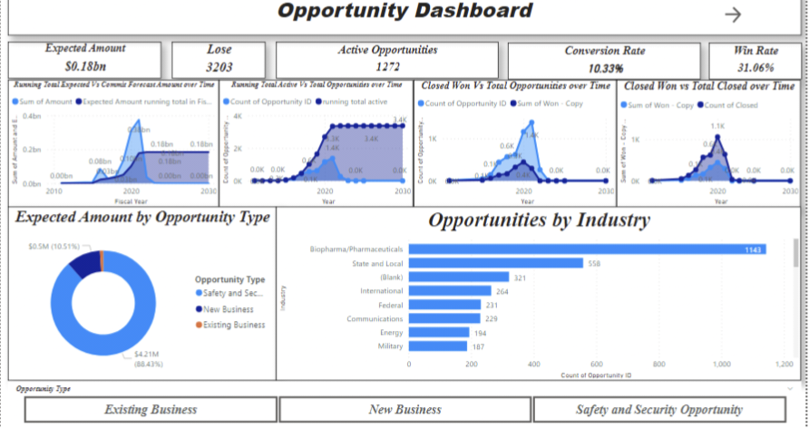
Power BI:

Slide 12
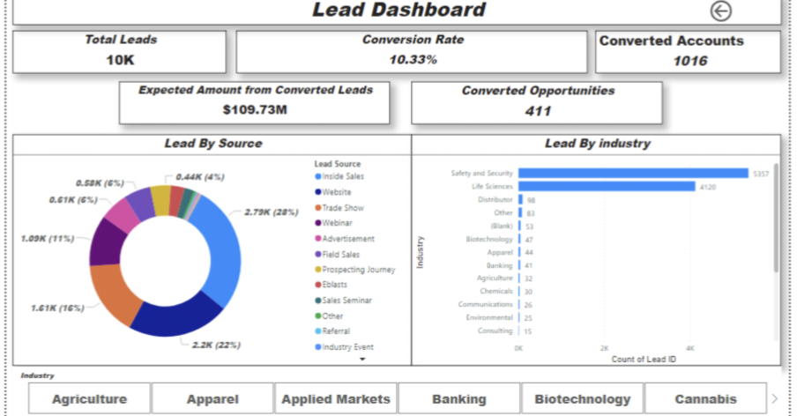
Power BI:

Slide 13
Key Takeaways:
Leads are potential customers who have shown interest in your offer but haven’t made a purchase yet.
Effective advertising is crucial for making potential customers aware of your business.
Understanding the ROI of your advertising efforts will help you optimize your lead generation strategy.

